Slide 1

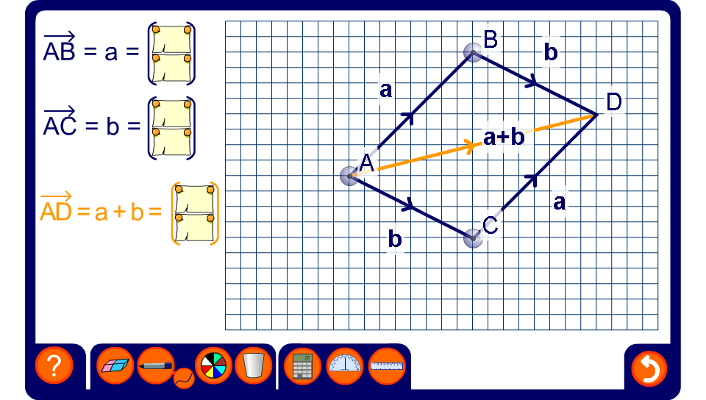


The resultant vector
Notes:
Start by clicking on vectors BD and CD to shade them out. The vectors a and b are then originating from the point A.
Explain that when two vectors start from the same point, the sum of the two vectors, the resultant vector, can be found by completing a parallelogram. The resultant vector goes from the starting point to the opposite corner of the parallelogram.
Give the real-life example of two forces represented by vectors a and b acting on a body at A. The resultant of these two forces is represented by a + b as shown from A.
The vectors in the diagram can be faded or revealed by clicking on them. Use this to show that a + b is equivalent to b + a.
This is sometimes called the parallelogram law.
Ask pupils to explain why the other diagonal in the parallelogram DB = a – b.

